Slide 1
unit - vi
Macro Economics

Slide 2
introduction
We have learnt all the economic issues in micro economics from the angle of a firm and also a consumer
We shall now look at all economic issues from the perspective of the economy (performance, structure and behaviour) and not one firm

Slide 3
introduction to macroeconomics
Modern economics has two major branches -Micro and Macro Economics
Macroeconomics came into existence in 1936
JM Keynes published his book The General Theory of Employment, Interest and Money
Micro Economics analyses economic behaviour of the individual decision making
Macroeconomics deals with the economic issues at the level of economy as a whole

Slide 4
Macroeconomics
Macroeconomics is the branch of economics that deals with a nation’s economy as a whole.
Macroeconomics focuses on the economic issues-unemployment, inflation, growth, trade, and the gross domestic product - that are most often discussed in the media and in political debates.

Slide 5
6.1 Circular flow of income
Economists use many different kinds of frameworks to make sense of an economy.
One of the most important is called the circular flow of income

Slide 6
example
When you purchase a of computer software, you give money to the seller, and the seller gives the software to you.
(You might literally hand over money and receive a CD, or you might enter a credit card number into a website entitling you to a download. The idea is the same either way.)
There is a flow of money from you to the seller and a flow of goods or services from the seller to you. This is true for all transactions: as individuals and firms buy and sell goods and services, money flows among the different sectors of the economy.
Macroeconomists follow the money. By tracking these flows, we can understand the links between different markets; by understanding these links, we gain insight into the functioning of an economy.

Slide 7
Circular flow of economic activities and income
The crux of macroeconomic theory is based on the circular flow of income
The basis of this flow is the economic interdependence of consumers and sellers, between whom the circular flow of production of goods & services, income and expenditure takes place
The simple model starts with the primary agents that is, households and firms which will be eventually extended by including the government and external sector

Slide 8
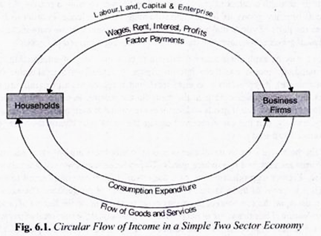
The Circular Flow – Two sector model

Slide 9
Circular flow diagram
The diagram above represents the transactions between firms and households in a simple economy.

Slide 10
Circular flow diagram
The diagram above represents the transactions between firms and households in a simple economy.
In the upper loop, the arrow originating from the households to the firms shows that firms hire labor and capital from households in order to produce goods and services. The arrow emanating from the firms indicates their payments for the use of the factors of production.
In the lower loop, the arrow emanating from firms to households represents the sale by firms of goods and services to households. On the other hand, the arrow from households to firms represents the payments.

Slide 11
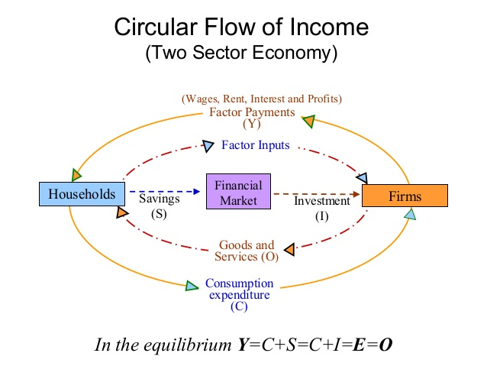

Slide 12
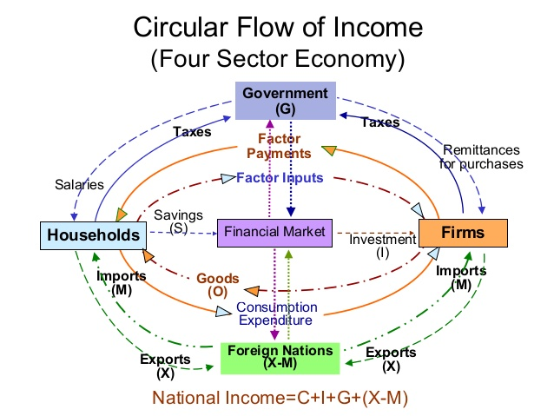
/ Subsidies
Transfer payments /

Slide 13
Injections and Leakages
Injections are items which add to the circular flow of income. These are investment (I), government spending (G) and exports (X).
Leakages from the circular flow are those items which lead to lower income flows; these are saving (S), taxes (T) and imports (M).

Slide 14
Domestic View of Macro Economy
Domestic View –
Consumers
Business Firms
Government
International View –
Foreign Trade

Slide 15
Five Sectors
Household sector – Consumption / Saving
Production / Firm - Investment
Financial Sector – Acts as an Intermediary – Monetary Policy
Government – Fiscal Policy
External – International Trade - BOP

Slide 16
Three Types of Markets -
Goods Market – Goods & Services are produced & consumed
Factors Market – Land, Labour, Money Market
Forex Market – Currencies are traded

Slide 17
Review question
Which of the following is NOT a leakage from the circular flow of income and expenditure:
a) Imports
b) Government purchases
c) Taxes
d) Saving

